Slide 1

Android Maps & Location APIs
Pune Google Developer Group
COEP Pune
-Rohit Lagu
10/11/2012

Slide 2
About “I - Me - Myself”
I am an Android Application Developer

Slide 3
Agenda
Google Maps in Fun Facts
Google Maps in Android
Location in Android
Places API
Creating App
Questions
Notes:
First I am going to show you how to integrate Google Maps on your Application, then I’ll continue with Location on Android and Finally I will give you the link with the code and you can ask me questions about this session

Slide 4
Google Maps in Fun Facts
2,337 – The number of mashups using Google’s API that are listed on ProgrammableWeb.
15% – This is the usage share of the Google Maps API, currently the most used API tracked by ProgrammableWeb..
25,000 – The maximum number of map loads any Google Maps API may generate per day for up to 90 consecutive days without incurring a cost.
800-1500 feet – The altitude from which most of the high-resolution imagery of cities you find in Google Maps are taken, even though Google uses the word satellite.
0 – If you try to look at North Korea using Google Maps you will only see the satellite image. It’s the only country in the world with no data available in Google Maps.

Slide 5
Google Maps in Fun Facts
23 – The maximum zoom level in Google Maps, only available in a small number of places. In most areas the zoom level stops at 20.
12 billion – The number of miles per year that Google Maps Navigation, included on Android handsets, has guided users.
2 years – The time saved per day for users of Google Maps Navigation with the traffic routing functionality.
1.18% – The share of sites in the top 10,000 of that use Google Maps
1,162,460 – In total, this many sites use Google Maps.

Slide 6
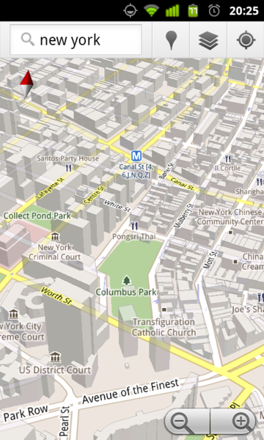
Google Maps in Android
Search in plain English
Voice Search API
Search along route
Traffic view
Satellite view
Street View
Car dock mode
Compass
Current location

Slide 7
Google Maps in Android
MapActivity: Base class with code to manage the boring necessities of any activity that displays a MapView
MapView: A View which displays a map (with data obtained from the Google Maps service).
MapController: A utility class to manage panning and zooming of a map.
MyLocationOverlay: An Overlay for drawing the user's current location (and accuracy) on the map, and/or a compass-rose inset.

Slide 8
Google Maps in Android
GeoPoint: longitude/latitude stored as integer in microdegrees (degrees * 1E6)
Overlay: Base class representing an overlay which may be displayed on top of a map
OverlayItem: The basic component of any ItemizedOverlay.
ItemizedOverlay: A base class for an Overlay which consists of a list of OverlayItems
Projection: A Projection serves to translate between the coordinate system latitude/longitude

Slide 9
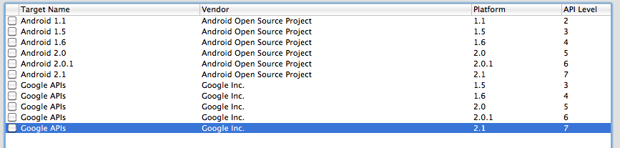
Prerequisites
Create an Android project with Google APIs support

Slide 10
Prerequisites
Manifest Permissions:
Add permission to use Google Maps external library
<uses-library android:name="com.google.android.maps" />
Add permission to use Internet
<uses-permission android:name="android.permission.INTERNET" />
Google Maps API key for mobile:
http://tinyurl.com/androidkeyapi

Slide 11
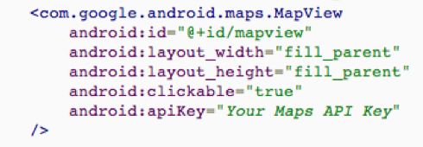
MapView
XML Definition MapView

Slide 12
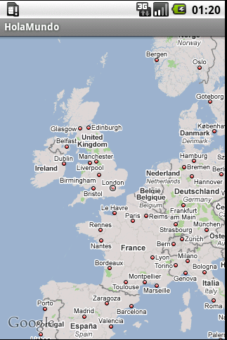
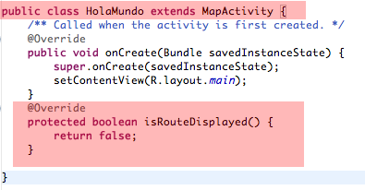
MapActivity
Create MapActivity to show the MapView

Slide 13
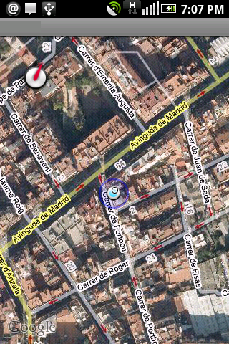

MyLocationOverlay
This object create an overlay that shows your location.
Notes:
24/06/09
13

Slide 14
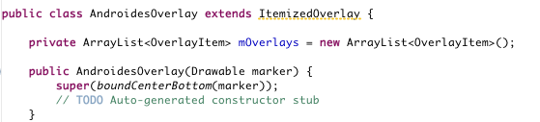
Custom Map Marker
Object that extends ItemizedOverlay
Object is initialize with a Drawable our custom marker

Slide 15
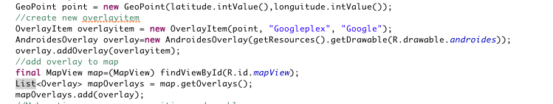
Custom Map Marker
Populate our custom marker ItemizedOverlay with OverlayItems
Finally, add our custom marker Overlay to MapView Overlays

Slide 16
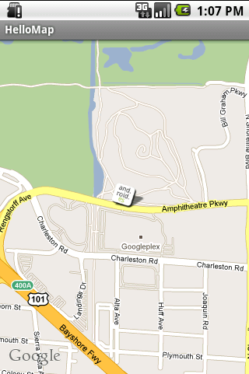
Hello Map

Slide 17
In Summary
MapActivty
MapView
List<Overlay>
MapController
Overlay1 (Geopoint1)
Overlay2 (Geopoint2)

Slide 18
Places API
Place Searches: List of Places based on a user's location or search string.
Place Details: Detailed information about a specific Place, including user reviews.
Place Actions: Sync data in Google's Places Database with data from your application.
Places Autocomplete: Autocomplete functionality for text-based geographic searches, by returning Places as you type.
Notes:
You can schedule Events, add and remove Places, or weight Place rankings from user activity with Place Bumps.

Slide 19
Prerequisites
Manifest Permissions:
Add permission to use Internet
<uses-permission android:name="android.permission.INTERNET" />
Google Maps API key for mobile:
http://tinyurl.com/placesAPI

Slide 20
Place Search
URL: http://tinyurl.com/places-search
Output: Json /XML
Parameters:
Required
optional
Keyword
Location
key
Radius
sensor
Language
Type
rank by

Slide 21
In nutshell
Place API registration
Selecting action URL
Add Parameters
Call URL & show Data

Slide 22
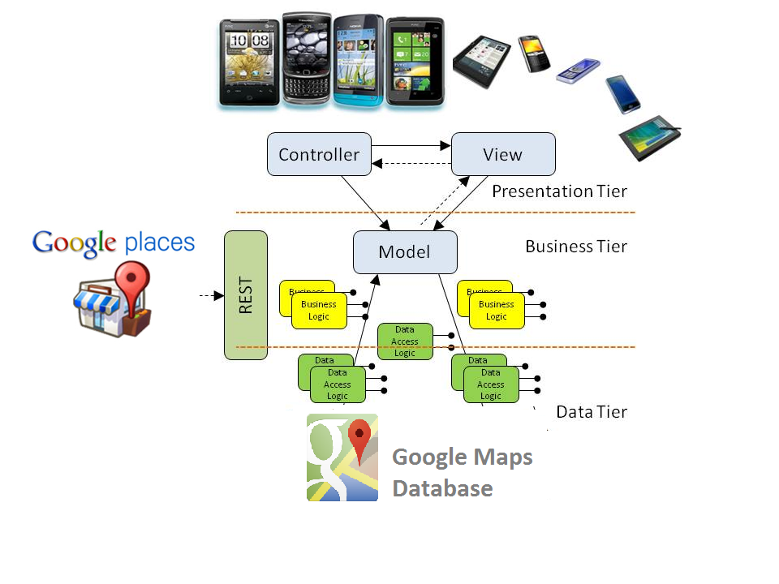
App: Around Pune

Slide 23
Q&A
Questions?

Slide 24
Thanks
Rohit Lagu
Mail: lagurohit@gmail.com

